Slide 1
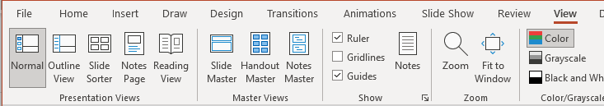
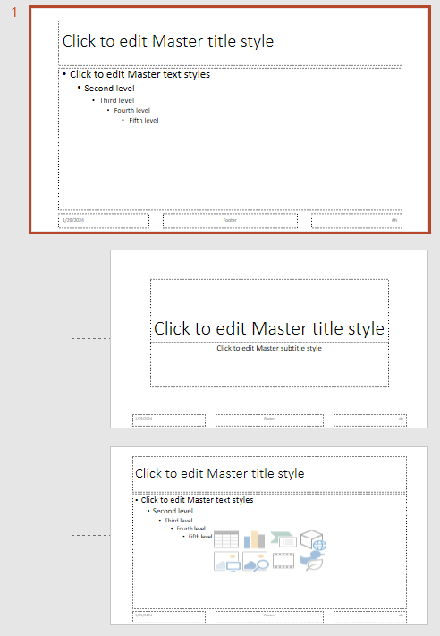
End Investor Slides: Add Your Logo
Recommended
logo position
If you are a financial advisor, you can add your logo to slides and reuse this material with your existing or prospective clients.
To add your logo:
Click View
Click Slide Master
Paste the image onto the first slide
1
Click
View
2
Click
Slide Master
1
Insert logo
on the first slide
in Slide Master
2
3
LOGO
3
231534

Slide 2


Slide 3


Slide 4
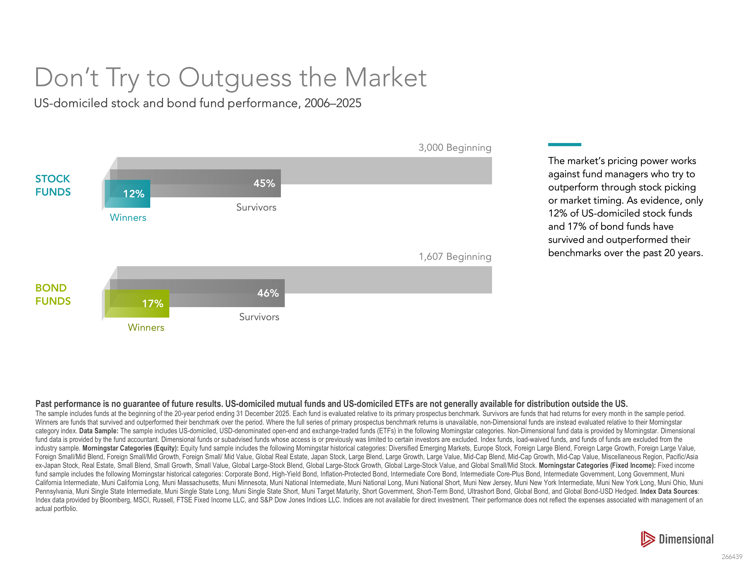

Slide 5
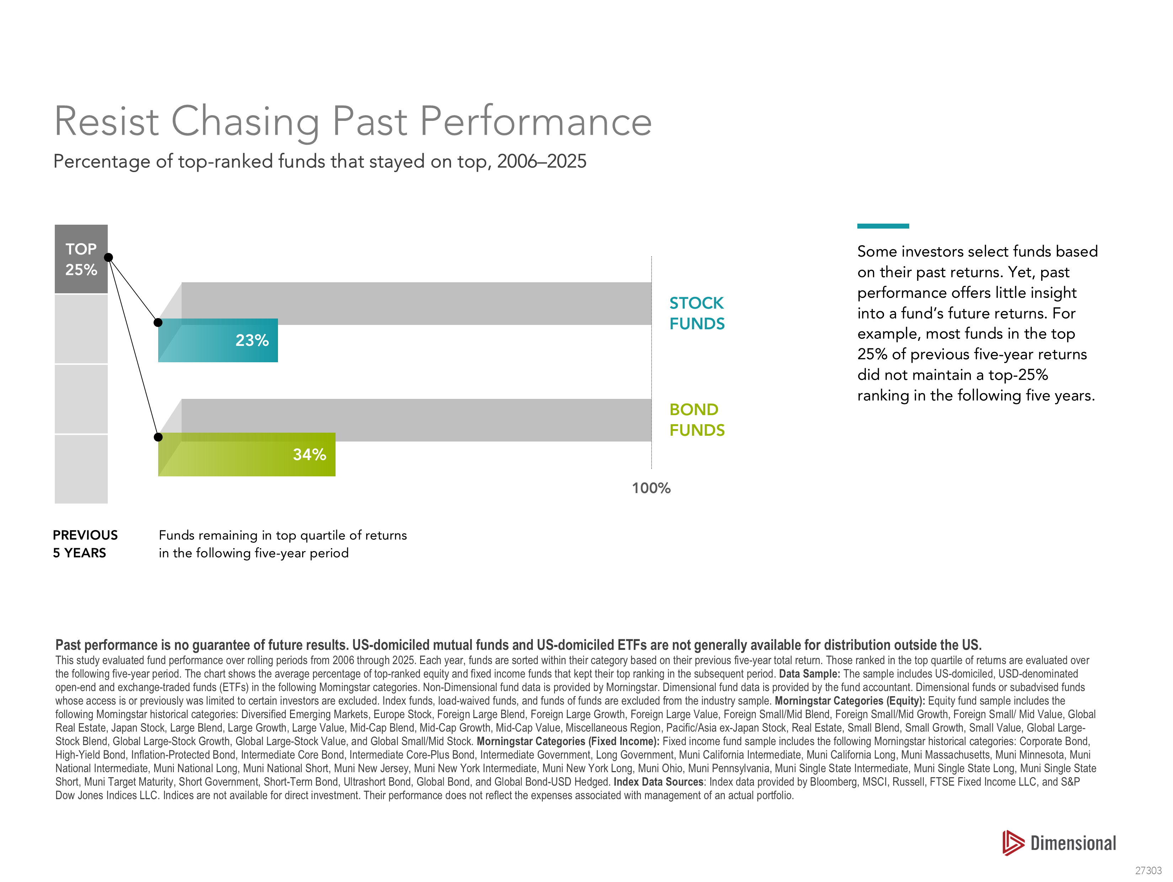

Slide 6
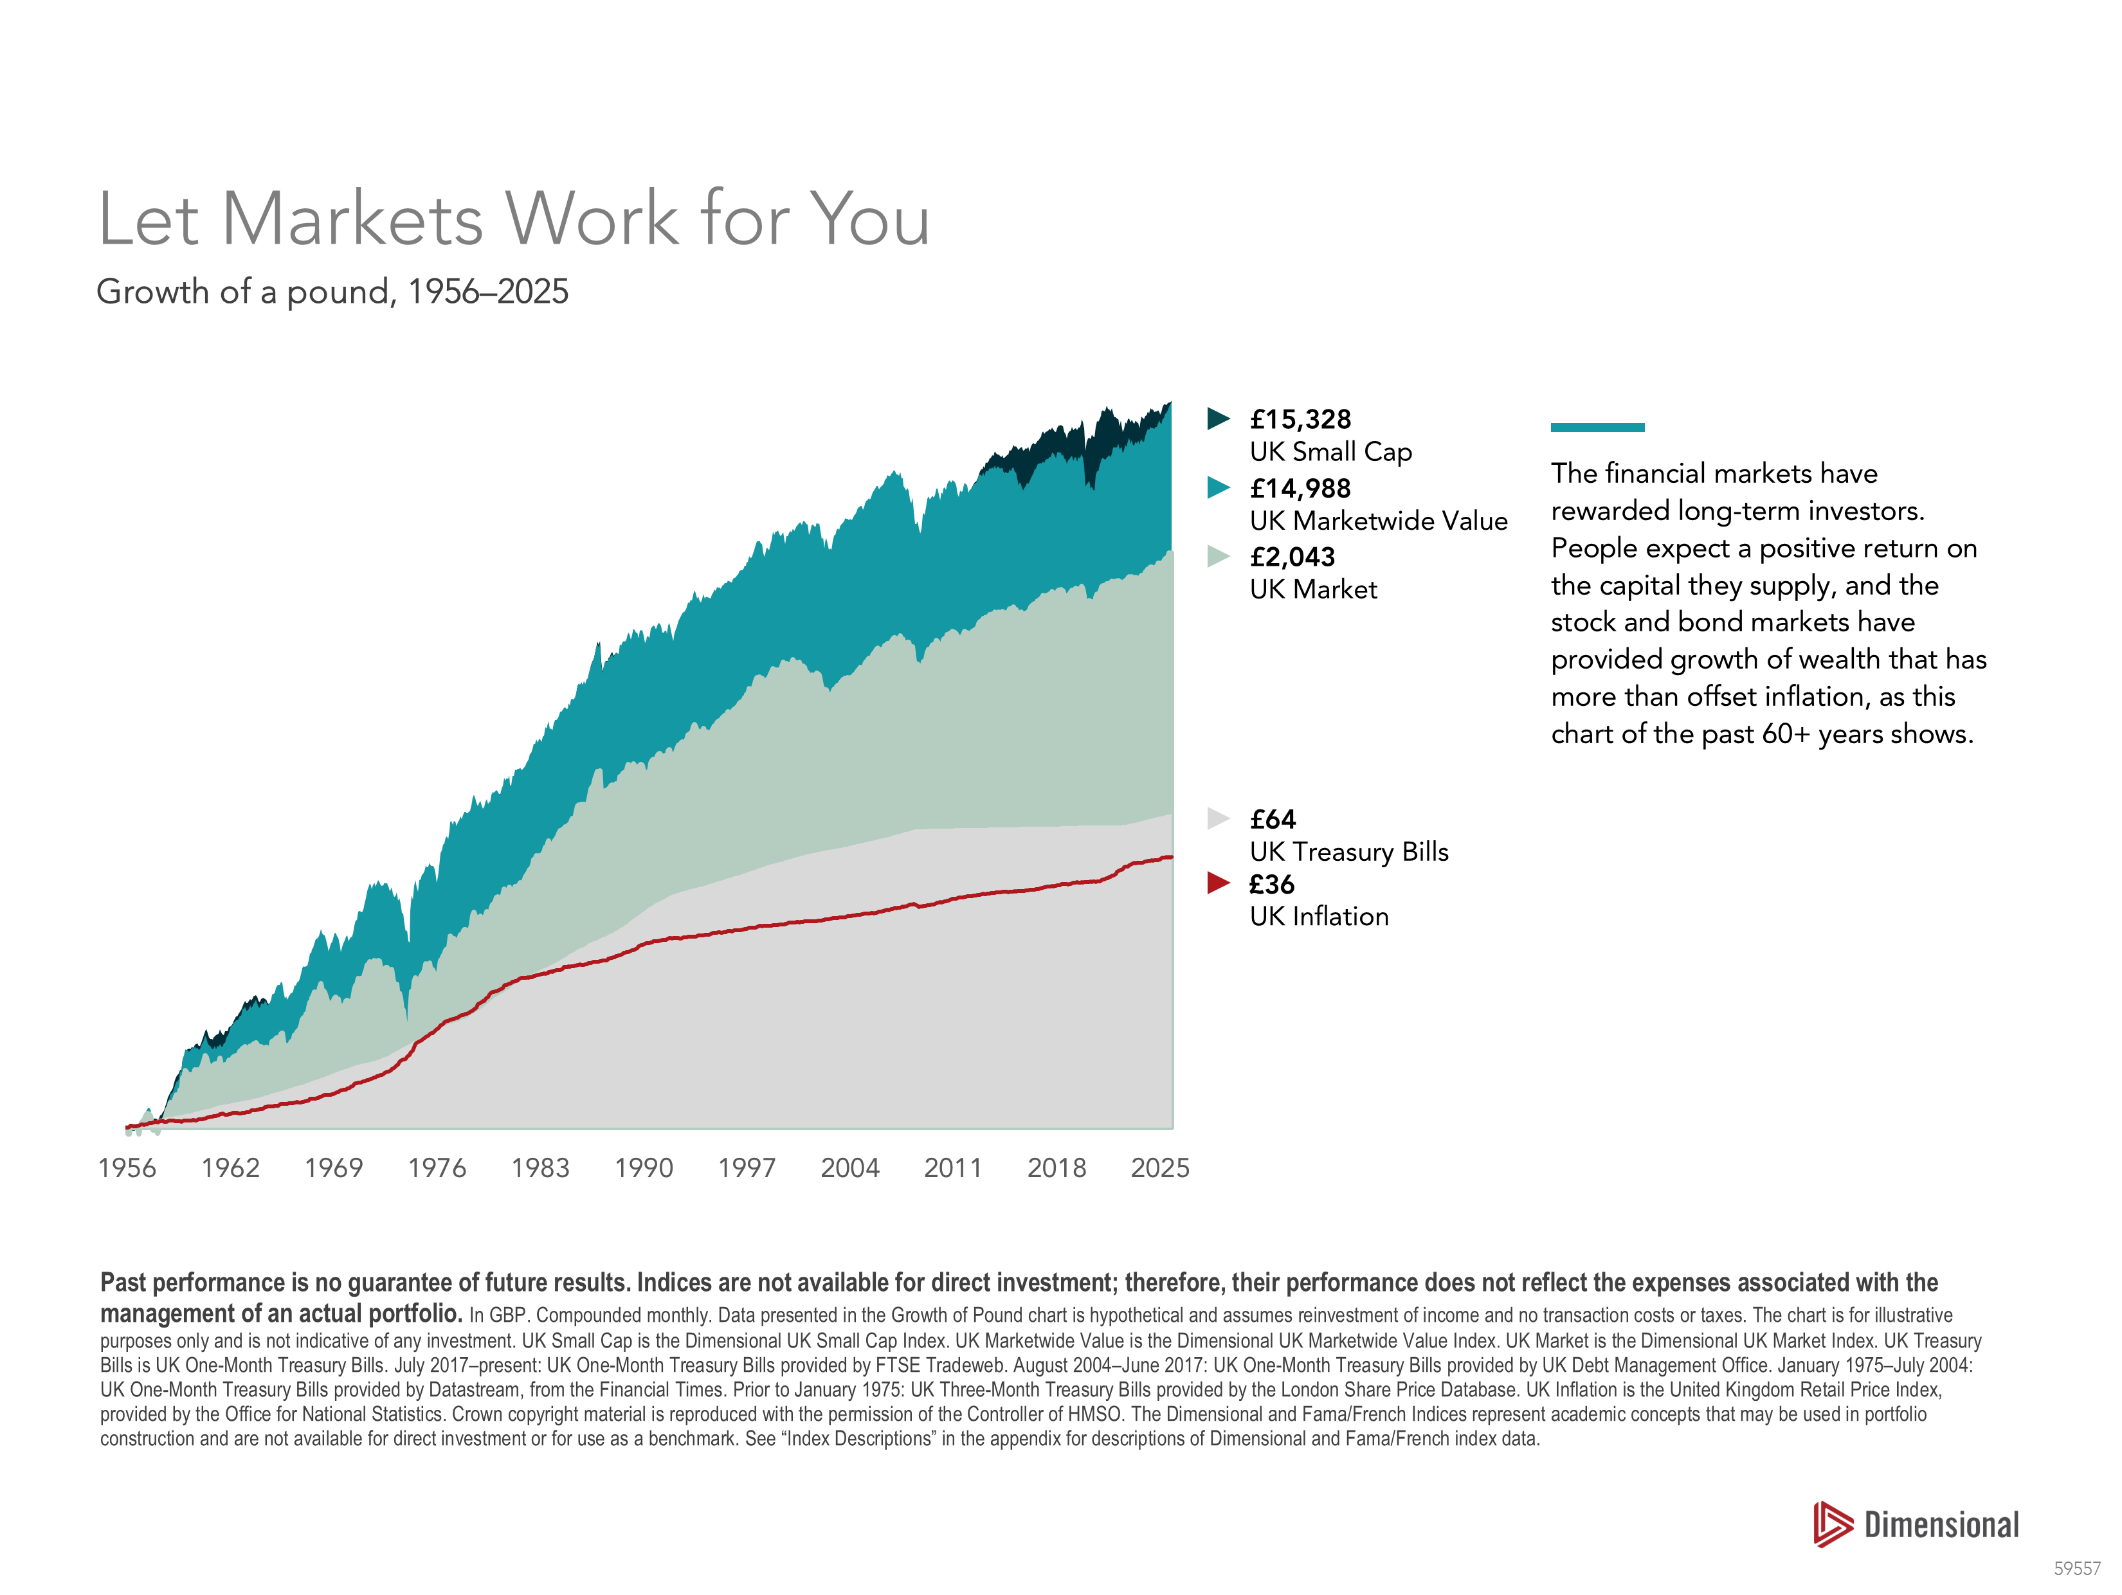

Slide 7
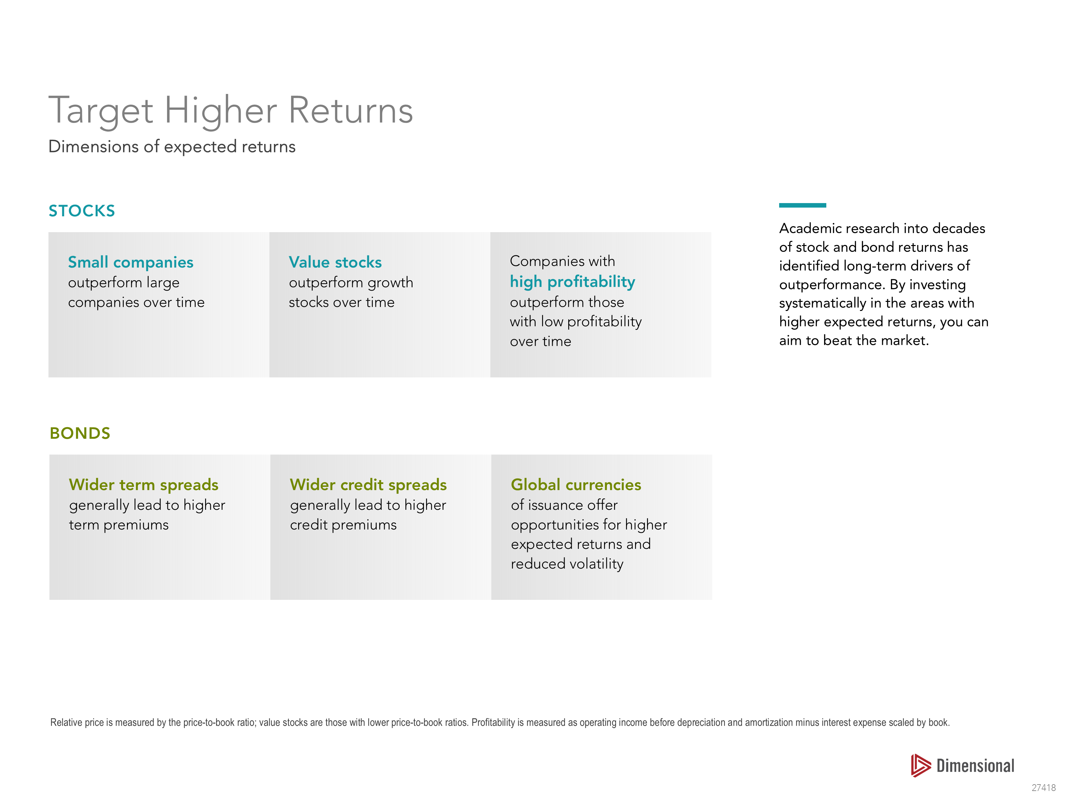

Slide 8


Slide 9
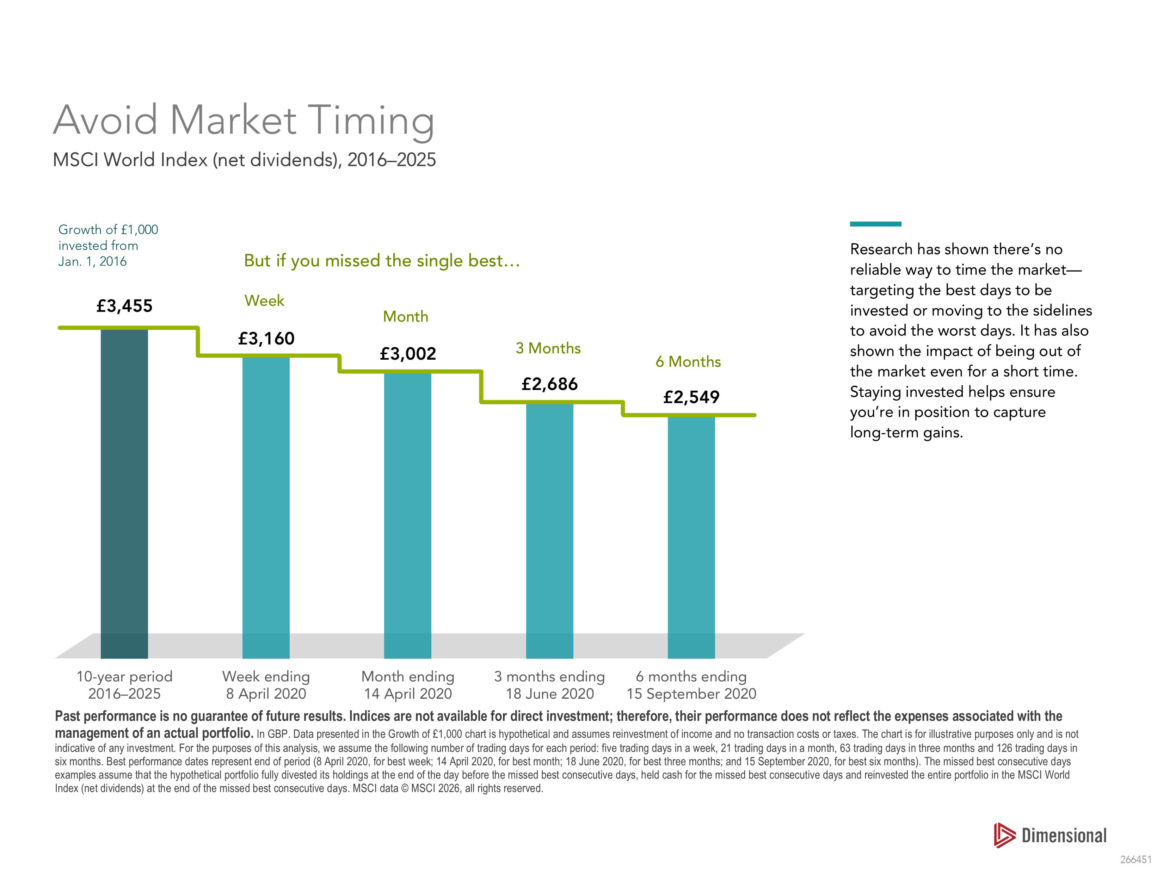

Slide 10


Slide 11


Slide 12
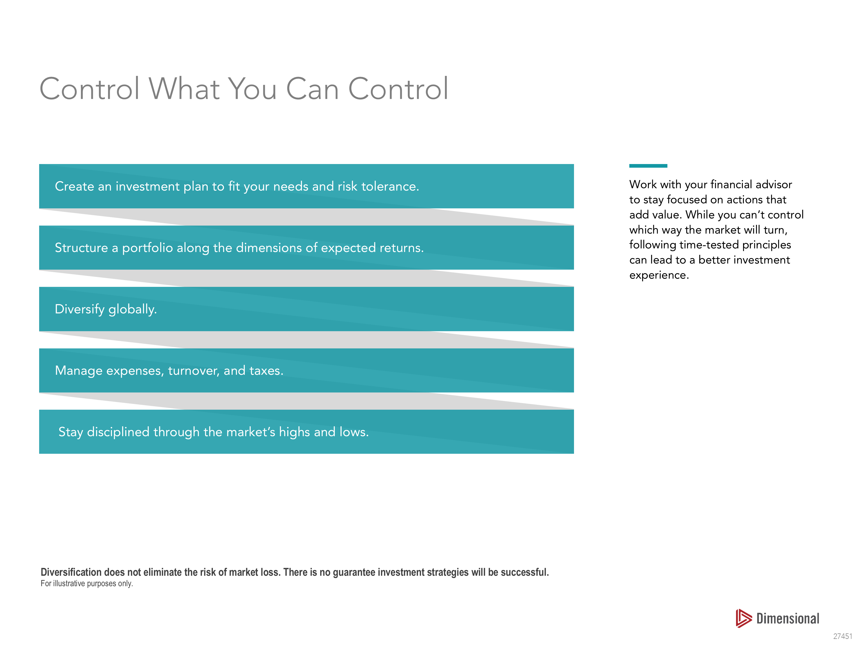

Slide 13


Slide 14


Slide 15


Slide 16


